Slide 1

FOSS LAB PROJECT
Submitted By:
Jeevamol Seby (61) Jenat Jose (62) Jibin George (63)

Slide 2
PROBLEM
Given a file name and number of lines, Print that much lines of the file

Slide 3
SOLUTION
This Project was implemented using PyQt.
Step 1 : Creating GUI using Qt Designer with extension ( .ui )
Step 2 : Creating a python file with the previously created GUI.
Step 3 : Run the Python File

Slide 4
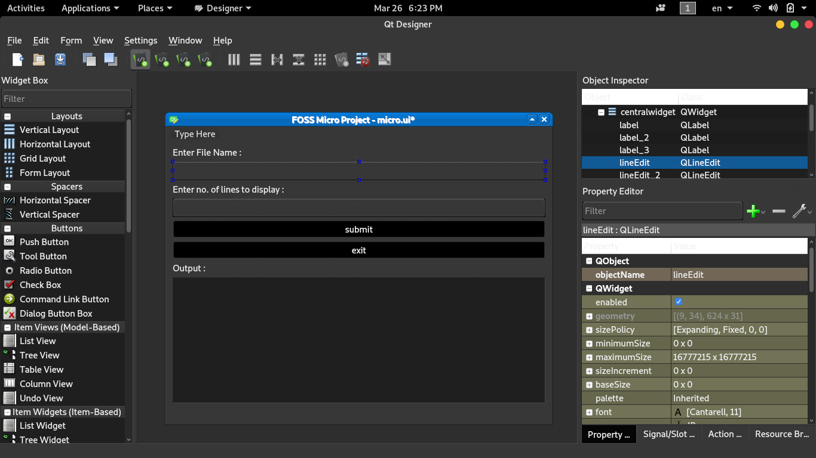
GUI FILE (micro.ui)

Slide 5
Python File (micro.py)
import os,sys
from PyQt5 import QtWidgets,uic,QtGui,QtCore
def print():
v=str(call.lineEdit.text())
v2=str(call.lineEdit_2.text())
cmd = ("head -n " + v2 + " " + v)
result_code = os.system(cmd + ' > output.txt') #cmd hold the shell command
if os.path.exists('output.txt'):
fp = open('output.txt', "r")
output = fp.read()
fp.close()
os.remove('output.txt')
call.textEdit.setText(output)
app = QtWidgets.QApplication(sys.argv)
call = uic.loadUi("micro.ui")
call.pushButton_2.clicked.connect(QtCore.QCoreApplication.instance().quit) #for exit button
call.pushButton.clicked.connect(print) #for submiting the shell command and display the output
call.show()
app.exec()

Slide 6
def print():
v=str(call.lineEdit.text()) # the given filename is stored in ‘ v ’
v2=str(call.lineEdit_2.text()) # the no. of line to display is stored in ‘ v2 ’
cmd = ("head -n " + v2 + " " + v) # cmd hold the shell command
result_code = os.system(cmd + ' > output.txt’) # output of shell command is given to a file
if os.path.exists('output.txt'):
fp = open('output.txt', "r")
output = fp.read() # output contains the given required output
fp.close()
os.remove('output.txt')
call.textEdit.setText(output) # displays the required output in GUI
xx

Slide 7
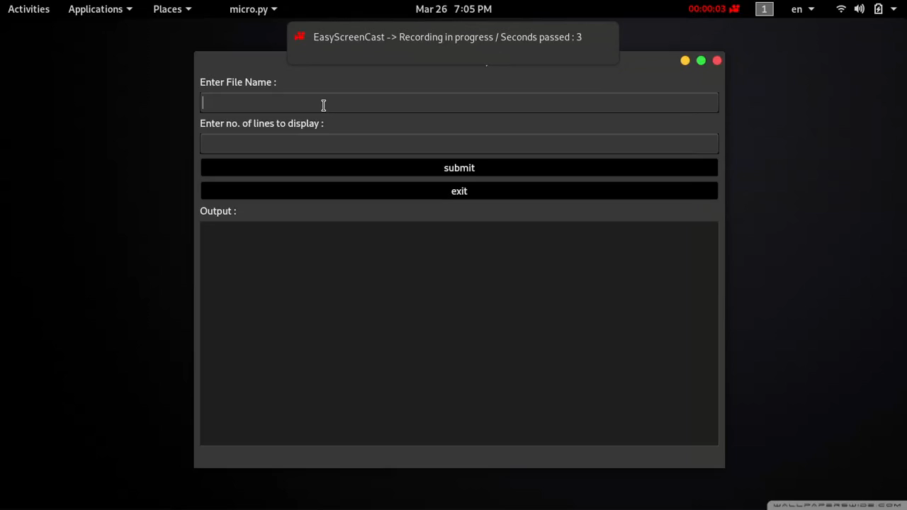
demo

Slide 8

Thank you
Our GitHub Repository
https://github.com/t0p3/Last3-s4csa
Team Member :
Jeevamol Seby ( 63 )
Jenat Jose ( 62 )
Jibin George ( 63 )

